Slide 1
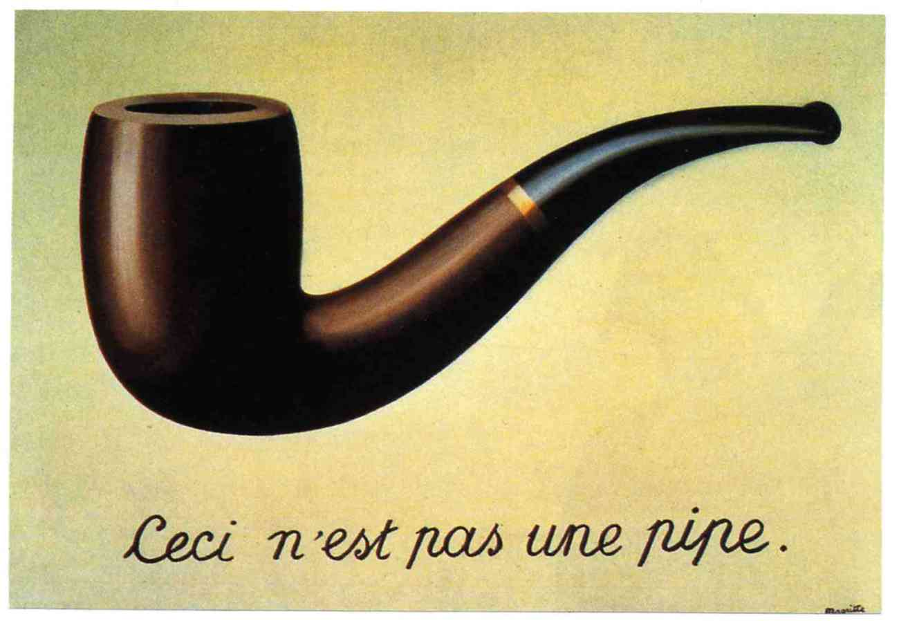
Proof by Contradiction
Discrete Structures (CS 173)
Madhusudan Parthasarathy, University of Illinois

Slide 2
Proof by Contradiction
Sometimes you want to show that something is impossible
$\sqrt{2}$ cannot be written as a ratio of integers
There is no compression algorithm that reduces the size of all files
A cycle with an odd number of nodes can’t be colored with two colors
Difficult to prove non-existence directly, and can’t prove by example
Solution: show that the negation of the claim leads to a contradiction

Slide 3
Contradiction
A set of propositions is a contradiction if their conjunction is always false
Contradiction?
$p∧¬p$
$p∨¬p$
$(x>5)∧(x>21)$
$x=20$ and $x$ is odd
$(x>5)∧(x<21)$
$(x<5)∧(x>21)$
$x$ is negative number and $\sqrt{x}$ is real

Slide 4
Proof by contradiction
Claim: There are infinitely many prime numbers
Equivalent claim: There is not a finite set of primes.

Slide 5
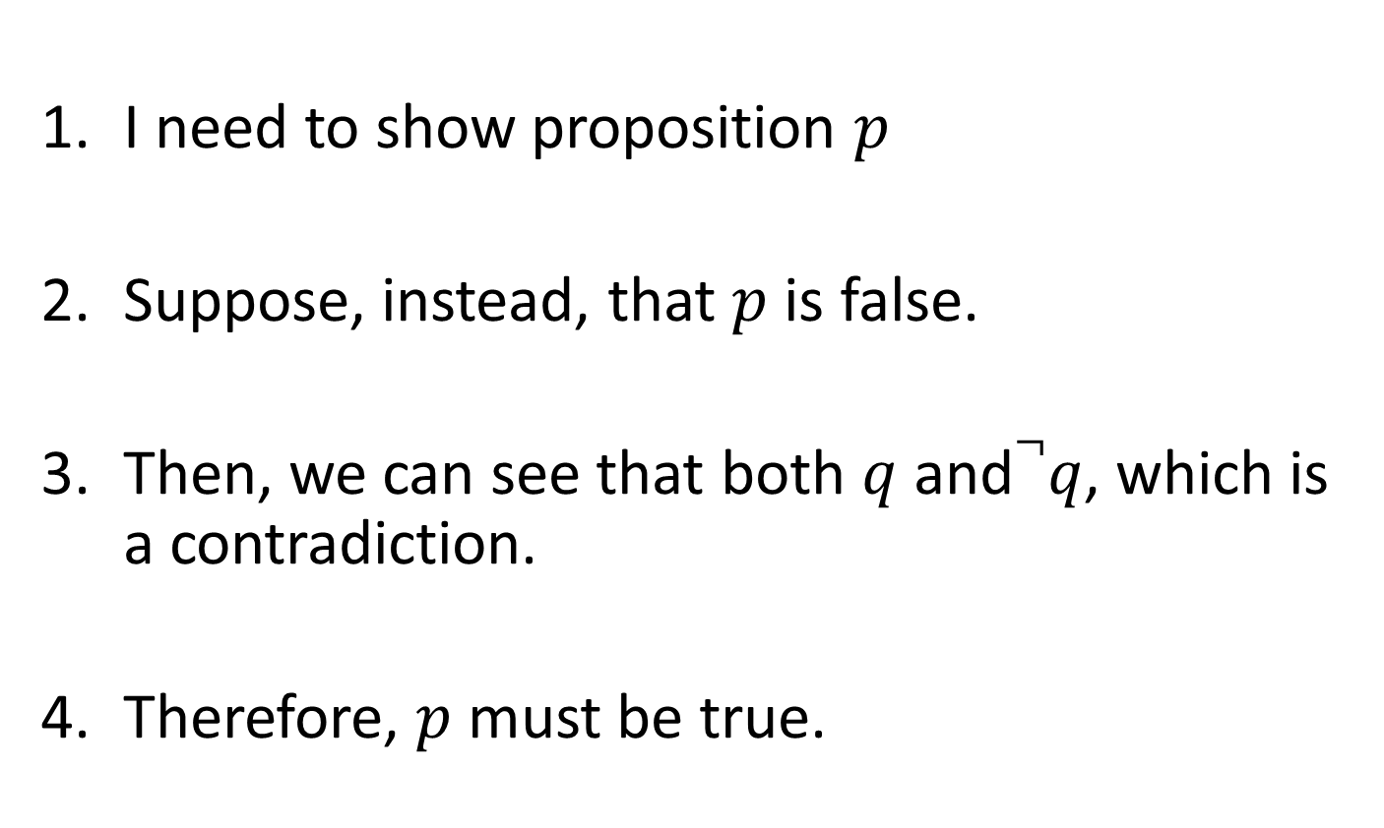
Basic form of proof by contradiction
I need to show proposition $p$
Suppose, instead, that $p$ is false.
Then, we can see that both $q$ and$¬q$, which is a contradiction.
Therefore, $p$ must be true.

Slide 6
Why proof by contradiction works
We need to prove proposition $p$
Instead, we show $¬p→F$, i.e., that we can conclude a contradiction from not $p$
By contrapositive, $¬p→F≡T→p≡p$

Slide 7
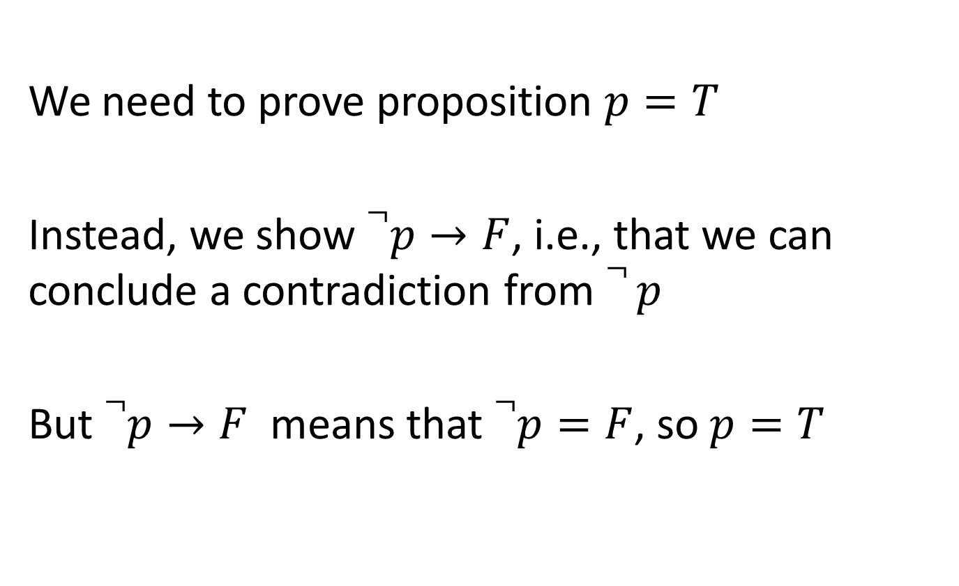
Another explanation
We need to prove proposition $p=T$
Instead, we show $¬p→F$, i.e., that we can conclude a contradiction from $¬ p$
But $¬p→F$ means that $¬p=F$, so $p=T$

Slide 8
Danger of proof by contradiction: a mistake in the proof might also lead to a contradiction
See this blog post about P=NP problem
http://rjlipton.wordpress.com/2011/01/08/proofs-by-contradiction-and-other-dangers/

Slide 9
Proof by contradiction
Claim: $\sqrt{2}$ is irrational
Equivalent claim: There does not exist a pair of integers $a, b$ without common factors such that $\frac{a}{b}=\sqrt{2}$

Slide 10
Proof by contradiction
Claim: No lossless compression algorithm can reduce the size of every file.
Notes:
Suppose your boss tells you to create an audio compression algorithm that is guaranteed to reduce the size of any file. You realize that this is an impossible task and want to prove it. How?

Slide 11
Why image compression works: images are mostly smooth

Slide 12
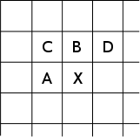
Lossless compression (PNG)
Predict that a pixel’s value based on its upper-left neighborhood
Store difference of predicted and actual value
Pkzip it (DEFLATE algorithm)

Slide 13
Proof by contradiction
Claim: A cycle graph with an odd number of nodes is not 2-colorable.

Slide 14
Proof by contradiction or contrapositive
Claim: For all integers $n$, if $n^{2}$ is odd, then $n$ is odd.
Notes:
Prove by contradiction, then prove by contrapositive.

Slide 15
When to use each type of proof
Match the situation to the proof type
Situation
Can see how conclusion directly follows from hypothesis
Need to demonstrate claim for an unbounded set of integers
Easier to show that negation of hypothesis follows from negation of conclusion
Need to show that something doesn’t exist
Need to show that something exists
Proof type
Direct proof
Proof by example or counter-example
Proof by contrapositive (or logical equivalence)
Induction
Proof by contradiction

Slide 16
When to use each type of proof
Match the situation to the proof type
Situation
Can see how conclusion directly follows from claim (a)
Need to demonstrate claim for an unbounded set of integers (d)
Easier to show that negation of hypothesis follows from negation of conclusion (c)
Need to show that something doesn’t exist (e)
Need to show that something exists (b)
Proof type
Direct proof
Proof by example or counter-example
Proof by contrapositive (or logical equivalence)
Induction
Proof by contradiction

Slide 17
When to use each type of proof
Match the claim to the suitable proof type
Claim
There is no real $x$, such that $x^{2}<0.$
If $n^{2}$ is odd, then $n$ is odd.
There is an integer $x$, such that $x^{2}=0$.
If $n$ is odd, then $n^{2}$ is odd.
All trees have more nodes than edges.
A wheel graph can’t be colored with two colors.
Not every natural number is a square.
The sum of two rational numbers is rational.
An even number can’t be created from the product of odd numbers.
Proof type
Direct proof
Proof by example or counter-example
Proof by contrapositive (or logical equivalence)
Induction
Proof by contradiction

Slide 18
Next class
Collections of sets
Sets of sets
Powersets
Partitions

